Slide 1
Introduction

Slide 2
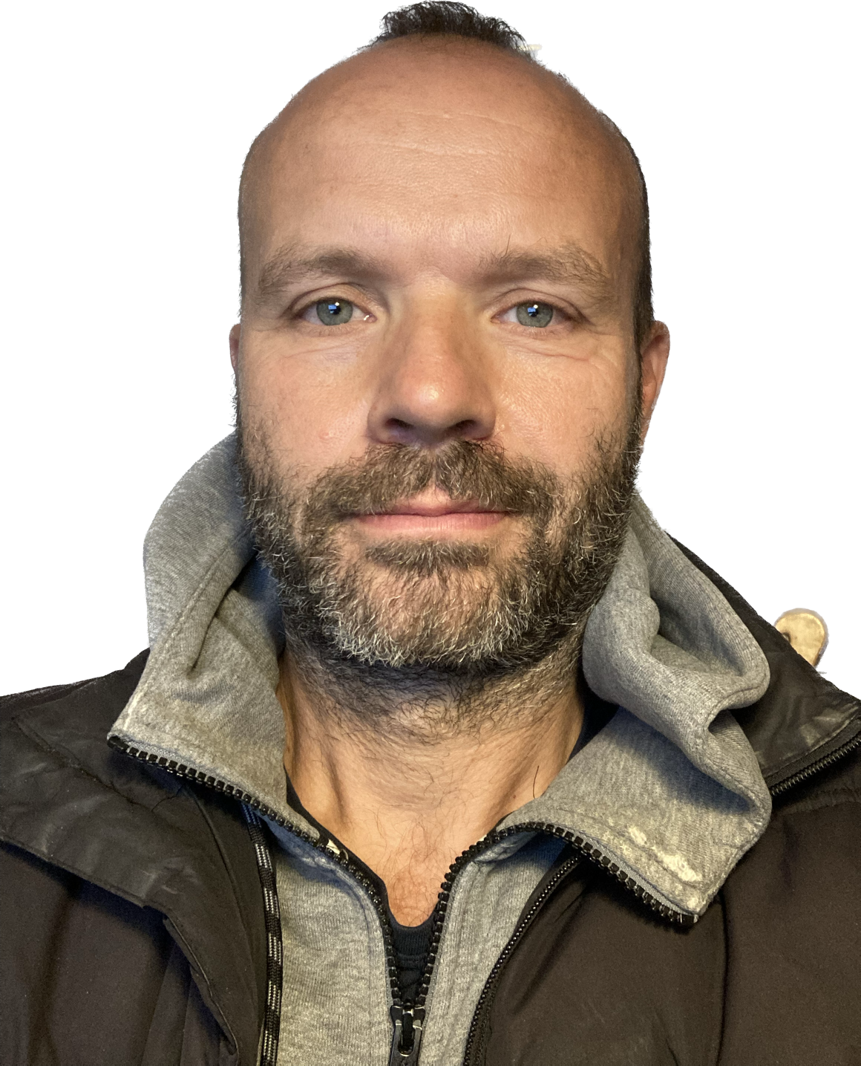
Whoami
Martin Højgaard Clausen
Live in Copenhagen area
Civil engineer from DTU, 1998
Independent consultant since 2010
Email: mhh.clausen@gmail.com

Slide 3

Agenda – 2 days
Day one
Introduction
Kafka overview
Kafka broker
Kafka producer
Kafka consumer
Day two
Kafka Spring
Kafka Streams
Kafka Connect
Day one
Introduction
Kafka overview
Kafka broker
Kafka producer
Kafka consumer
Day two
Kafka Spring
Kafka Streams
Kafka Connect

Slide 4

Goals
Be familiar with principles, benefits and challenges with distributed systems and in particular event driven architecture (EDA).
Explain the Kafka platform and its architecture.
Be able to build a Spring Boot application that integrates with Kafka.

Slide 5


Tell us about yourself
What is your job role?
Years of experience?
Have you worked with Kafka previously – or related technologies?
Are you planning to use Kafka?
What are your expectations for this course?

Slide 6
Practical stuff
All exercises will be done on a vm running in Azure
Exercises can be worked on individually or in groups as you prefer
Solutions are provided for most exercises
Sometimes I will do the exercise and ask you to repeat it
Raise you hand or feel free to interrupt me if you have questions!
XX
Lunch time 11:30 - ?
Small coffee breaks every hour?
Anything else?

Slide 7
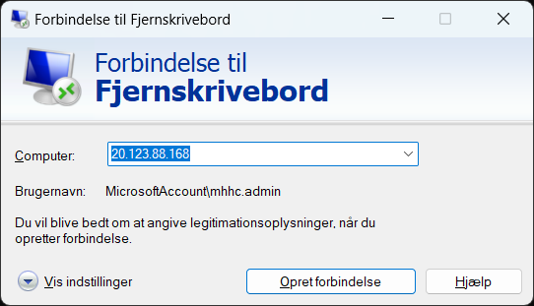
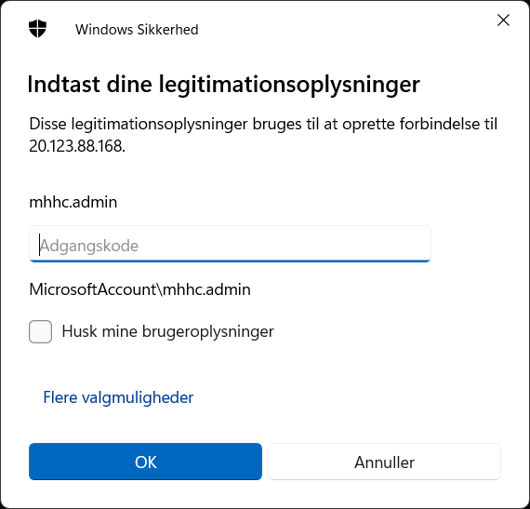
Exercise
Hand out of IP addresses
Login to virtual machine using Microsoft Terminal Services Client
Type mstsc in the search field and enter your IP address
Enter username and password mhhc.admin/thisissecret2023#
1.1

Slide 8
Exercise
Clone repository
Open windows powershell by typing ‘powershell’ in the search field in the taskbar
In powershell navigate to the root of your c: drive by typing cd\
Type: git clone https://github.com/LundOgBendsen/LB2628-Kafka.git
Type ls to see the folders in root. You should see a folder called LB2628-Kafka
Type cd LB2628-Kafka to navigate inside that folder.
Walk-thorough of the project folders
1.2

